Slide 1


Introduction to Clustering

Slide 2
Introduction to Clustering Analysis
Cluster analysis is part of the unsupervised learning. Clustering is the process of dividing the population or data points into a number of groups such that data points in the same groups are more similar to other data points in the same group than those in other groups. In simple words, the aim is to segregate groups with similar traits and assign them into clusters.
Suppose, you are the head of a marketing at amazon, and wish to understand preferences of your customers to scale up the agricultural part of the business. Is it possible for you to look at details of each customer and devise a unique business strategy for each one of them? Definitely not. But, what you can do is to cluster all of your customers into say 10 groups based on their purchasing habits and use a separate strategy for customers in each of these 10 groups. And this is what we call clustering.

Slide 3
Type of Clustering
Hard Clustering
Broadly speaking, clustering can be divided into two subgroups :
Hard Clustering.
Soft Clustering.
Hard Clustering: hard clustering is about grouping the data items such that each item is only assigned to one cluster. As an instance, we want the algorithm to read all of the tweets and determine if a tweet is a positive or a negative tweet.
K-Means is a famous hard clustering algorithm whereby the data items are clustered into K clusters such that each item only blogs to one cluster.

Slide 4
Type of Clustering
Soft Clustering
Soft Clustering: In soft clustering, instead of putting each data point into a separate cluster, a probability or likelihood of that data point to be in those clusters is assigned. In this type clustering a data points can be in multiple clusters since it is based on probability.
Fuzzy C-means is a famous soft clustering algorithm. It is based on the fuzzy logic and is often referred to as the FCM algorithm.

Slide 5
Types of Clustering Algorithm
Connectivity models: As the name implies, these models are based on the idea that data points closer together in data space are more similar to each other than data points farther apart. These models can take one of two approaches. In the first approach, they begin by categorizing all data points into separate clusters and then aggregate them as the distance between them decreases. The second approach classifies all data points as a single cluster and then partitions them as the distance increases. Furthermore, the selection of the distance function is subjective. These models are simple to understand but lack scalability when dealing with large datasets. Hierarchical clustering algorithms and variants are examples of these models.
Centroid models: are iterative clustering algorithms that derive similarity from the proximity of a data point to the cluster's centroid. The K-Means clustering algorithm is a popular example of this type of algorithm. The number of clusters required at the end of these models must be specified beforehand, which necessitates prior knowledge of the dataset. These models are iterated in order to find the local optima.

Slide 6
Types of Clustering Algorithm.
Distribution models:These clustering models are based on the idea of how likely it is that all data points in the cluster belong to the same distribution (For example: Normal, Gaussian). Overfitting is a common problem with these models. The Expectation-maximization algorithm, which uses multivariate normal distributions, is a popular example of one of these models.
Density Models: These models search the data space for areas with varying densities of data points. It isolates various densities and assigns data points within these densities to the same cluster. DBSCAN and OPTICS are two popular density models.

Slide 7
Hierarchical Clustering
Hierarchical clustering is an unsupervised learning method for clustering data points. The algorithm builds clusters by measuring the dissimilarities between data. Unsupervised learning means that a model does not have to be trained, and we do not need a "target" variable.
Hierarchical clustering method functions in two approaches-
Agglomerative
Divisive

Slide 8
Approaches of Hierarchical Clustering
Agglomerative clustering: Agglomerative Clustering is a bottom-up strategy in which each data point is initially a cluster of its own, and more pairs of clusters are combined as one moves up the hierarchy. It takes the two closest clusters and joins them to form a single cluster.
Divisive clustering: The divisive clustering algorithm is a top-down clustering strategy in which all points in the dataset are initially assigned to one cluster and then divided iteratively as one progresses down the hierarchy. It partitions data points that are clustered together into one cluster based on the slightest difference. This process continues till the desired number of clusters is obtained.

Slide 9
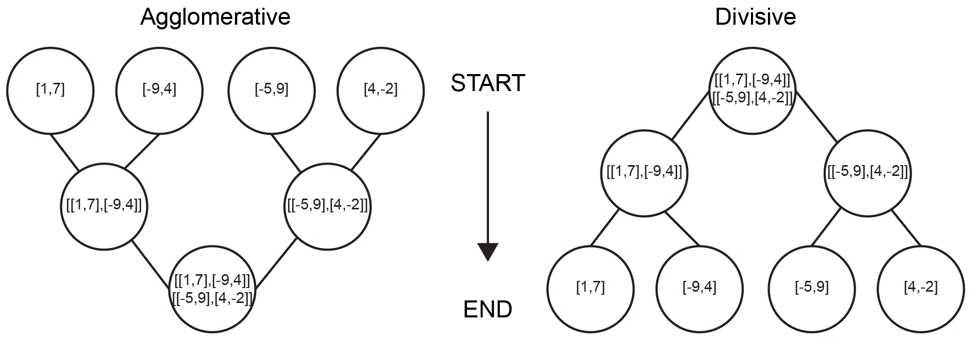

Slide 10
Working of Clustering Algorithm
Each observation is treated as a separate cluster in hierarchical clustering. After that, it repeats the next two steps:
Finds the two clusters that are the closest together (using distance measures)
Combines the two clusters that are the most similar. This iterative process is repeated until all of the clusters have been integrated
In it, there is one cluster that after combining with data points closest to it, starts getting bigger. The same cluster gets bigger as long as all the data points are inside a single cluster. After this, the cluster is divided with the development of the dendrogram as per our desired problem.

Slide 11
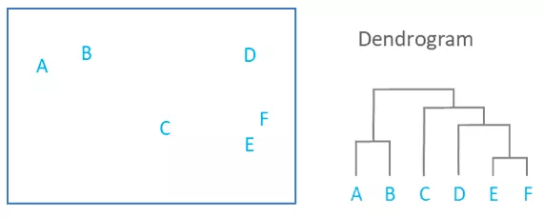
Dendrogram
A dendrogram is a diagram that shows the hierarchical relationship between objects. It is most commonly created as an output from hierarchical clustering. The main use of a dendrogram is to work out the best way to allocate objects to clusters. The dendrogram below shows the hierarchical clustering of six observations shown on the scatterplot to the left.

Slide 12
Interpreting Dendrogram
The key to interpreting a dendrogram is to focus on the height at which any two objects are joined together. In the example above, we can see that E and F are most similar, as the height of the link that joins them together is the smallest. The next two most similar objects are A and B.
In the dendrogram above, the height of the dendrogram indicates the order in which the clusters were joined. A more informative dendrogram can be created where the heights reflect the distance between the clusters as is shown below. In this case, the dendrogram shows us that the big difference between clusters is between the cluster of A and B versus that of C, D, E, and F.
For example, the dendrogram suggests that C and D are much closer to each other than is C to B, but the original data (shown in the scatterplot), shows us that this is not true. To use some jargon, a dendrogram is only accurate when data satisfies the ultrametric tree inequality, and this is unlikely for any real-world data.

Slide 13
Common Terms in Dendrogram
Clade: this is refer to as the branch. The arrangement of the clades tells us which leaves are most similar to each other. The height of the branch points indicates how similar or different they are from each other: the greater the height, the greater the difference.
Clades can have just one leaf (these are called simplicifolious, a term from botany that means “single leafed”) or they can have more than one. Two-leaved clades are bifolious, three-leaved are trifolius, and so on. There is no limit to the number of leaves in a clade.
Leaf: this is refer to each data points in the set of data you are trying to cluster.
Singleton: a clade that intercept with another.

Slide 14
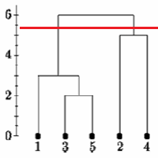
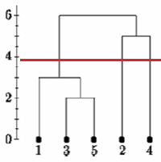
Problems Of Hierarchical Clustering
There is no clear way to really ascertain the number of clusters in a particular hierarchical cluster.
One of the problems with hierarchical clustering is that there is no objective way to say how many clusters there are. If we cut the single linkage tree at the point shown below, we would say that there are two clusters. However, if we cut the tree lower we might say that there is one cluster and two singletons.

Slide 15
Application of Hierarchical Clustering
Identifying fake news:
Identifying criminal activity:
Document Analysis:
Phylogenetic trees analysis
Tracking viruses through phylogenetic tree

Slide 16
K-Means Clustering
K means is an iterative clustering algorithm that aims to find local maxima in each iteration. The algorithm works as follow:
Step 1: Choose groups in the feature plan randomly
Step 2: Minimize the distance between the cluster center and the different observations (centroid). It results in groups with observations
Step 3: Shift the initial centroid to the mean of the coordinates within a group.
Step 4: Minimize the distance according to the new centroids. New boundaries are created. Thus, observations will move from one group to another Repeat until no observation changes groups

Slide 17
K-means Clustering
K-means usually use the Euclidean Distance
Distance(xi,yi)= sum(xi-yi)ˆ2
Different distance measures are available such as the Manhattan distance or Minkowski distance.
Another difficulty found with k-mean is the choice of the number of clusters. However, there is a rule of thumb to select the appropriate number of clusters
Cluster (k)= sqrt(2/n)
Where n= the number of observation in the dataset.

Slide 18
Example of K-Means Clustering
K means is not suitable for factor variables because it is based on the distance and discrete values do not return meaningful values. Let’s start by loading in the data.
library(dplyr)
library(animation)
PATH <-"https://raw.githubusercontent.com/guru99-edu/R-Programming/master/computers.csv"
df <- read.csv(PATH) %>%
select(-c(X, cd, multi, premium))
glimpse(df)

Slide 19
Summary Statistics
summary(df)
Rescaling
rescale_df <- df %>%
mutate(price_scal = scale(price),
hd_scal = scale(hd),
ram_scal = scale(ram),
screen_scal = scale(screen),
ads_scal = scale(ads),
trend_scal = scale(trend)) %>%
select(-c(price, speed, hd, ram, screen, ads, trend))
kmeans.ani(rescale_df[2:3], 3)

Slide 20
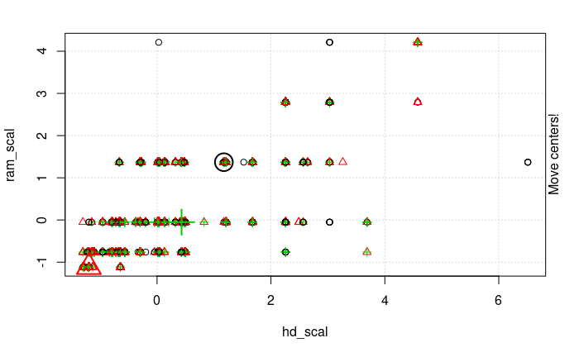
sudo apt-get install libmagick++-dev
library(animation)
kmeans.ani(rescale_df[2:3], 3)a

Slide 21
Explanation
You can interpret the animation as follow:
Step 1: R randomly chooses three points
Step 2: Compute the Euclidean distance and draw the clusters. You have one cluster in green at the bottom left, one large cluster colored in black at the right and a red one between them.
Step 3: Compute the centroid, i.e. the mean of the clusters.
Repeat until no data changes cluster

Slide 22
Using the Entire Data
Let’s run the k-mean algorithm in our dataset with optimal cluster and call it pc_cluster.
The list pc_cluster contains seven interesting elements:
cluster: Indicates the cluster of each observation
centers: The cluster centres
totss: The total sum of squares
withinss: Within sum of square. The number of components return is equal to k
tot.withinss: Sum of withinss betweenss: Total sum of square minus Within sum of square
size: Number of observation within each cluster.
You will use the sum of the within sum of square (i.e. tot.withinss) ‘to compute the optimal number of clusters k. Finding k is indeed a substantial task.

Slide 23
Optimal K Using Elbow Method
One technique to choose the best k is called the elbow method.
You can construct the elbow graph and find the optimal k as
Follow:
Step 1: Construct a function to compute the total within clusters sum of squares
kmean_withinss <- function(k) {
cluster <- kmeans(rescale_df, k)
return (cluster$tot.withinss)
}
kmean_withinss(2)
Step 2: Run the algorithm times
max_k <-20
# Run algorithm over a range of k using the sapply to loop through the range of data instead of writing a function for efficiency
wss <- sapply(2:max_k, kmean_withinss)

Slide 24
Optimizing K
Step 3: Create a data frame with the results of the algorithm
# Create a data frame to plot the graph
elbow <-data.frame(2:max_k, wss)
Step 4: Plot the results.
library(ggplot2)
# Plot the graph with ggplot
ggplot(elbow, aes(x = X2.max_k, y = wss)) +
geom_point() +
geom_line() +
scale_x_continuous(breaks = seq(1, 20, by = 1))

Slide 25
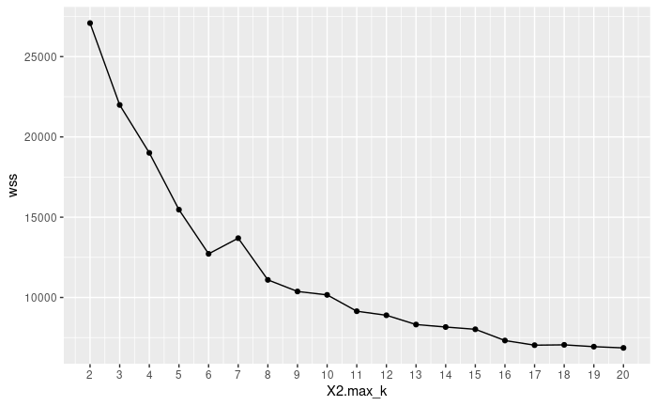
Optimal K

Slide 26
Implementing the K-Means with the optimal K
pc_cluster_2 <-kmeans(rescale_df, 3)
pc_cluster_2$size
The first cluster is composed of 545 observations, while the largest cluster, number 6, has only 1594 computers. It might be good to have homogeneity between clusters, if not, a thinner data preparation might be required.
You get a deeper look at the data with the center component. The rows refer to the numeration of the cluster and the columns the variables used by the algorithm. The values are the average score by each cluster for the interested column. Standardization makes the interpretation easier. Positive values indicate the z-score for a given cluster is above the overall mean. For instance, cluster 5 has the highest price average among all the clusters.

Slide 27
Adding our cluster to the data
center <- pc_cluster_2$centers
In other to highlight the difference between categories, we are going to use a ggplot with heatmap function to plot the graph.
To create a heat map, you proceed in three steps:
Build a data frame with the values of the center and create a variable with the number of the cluster
Reshape the data with the gather() function of the tidyr library. You want to transform data from wide to long.
Create the palette of colors with colorRampPalette() function
cluster <- c(1: 7)
center_df <- data.frame(cluster, center)

Slide 28
Implementing Heatmap
# Reshape the data
library(tidyverse)
center_reshape <- gather(center_df, features, values, price_scal: trend_scal)
head(center_reshape)
library(RColorBrewer)
# Create the palette
hm.palette <-colorRampPalette(rev(brewer.pal(10, 'RdYlGn')),space='Lab')

Slide 29
Plotting the cluster graph with ggplot
ggplot(data = center_reshape, aes(x = features, y = cluster, fill = values)) +
scale_y_continuous(breaks = seq(1, 7, by = 1)) +
geom_tile() +
coord_equal() +
scale_fill_gradientn(colours = hm.palette(90)) +
theme_classic()

Slide 30
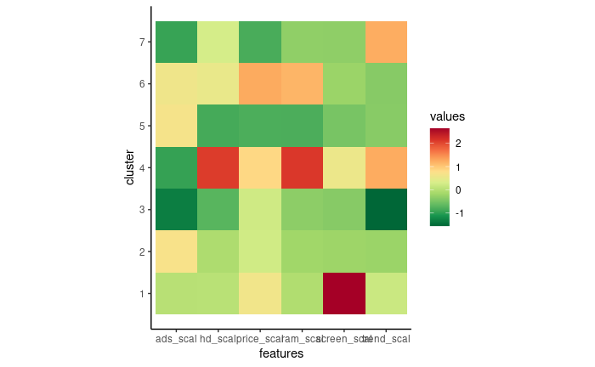

Slide 31
